Slide 1

Paddy crop monitoring & paddy yield forecasting
progress presentation 2

Slide 2
Methodology

Slide 3
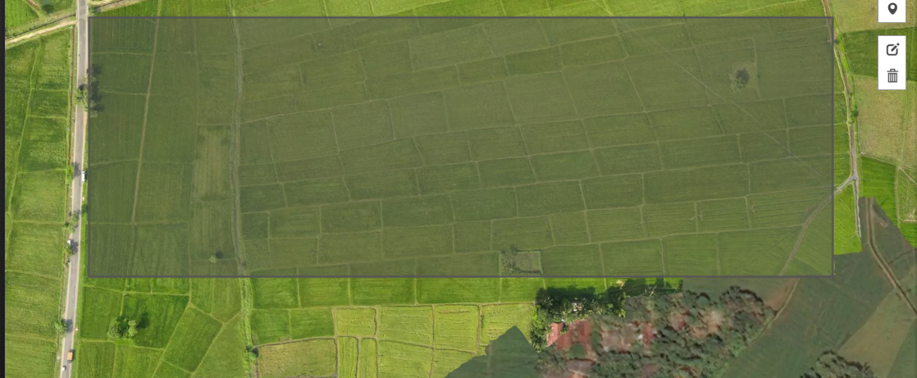
AOI
Notes:
15.92 arce
Gampaha, kirindiwita

Slide 4

Gathering Satellite images of AOI
Sentinel-hub cloud service
Sentinel 2-A satellite
Gathered imagery since 2015
Gathered NDVI values since 2015
B11,B08,B02 (agriculture monitoring)
< 20% cloud coverage
178 satellite images

Slide 5
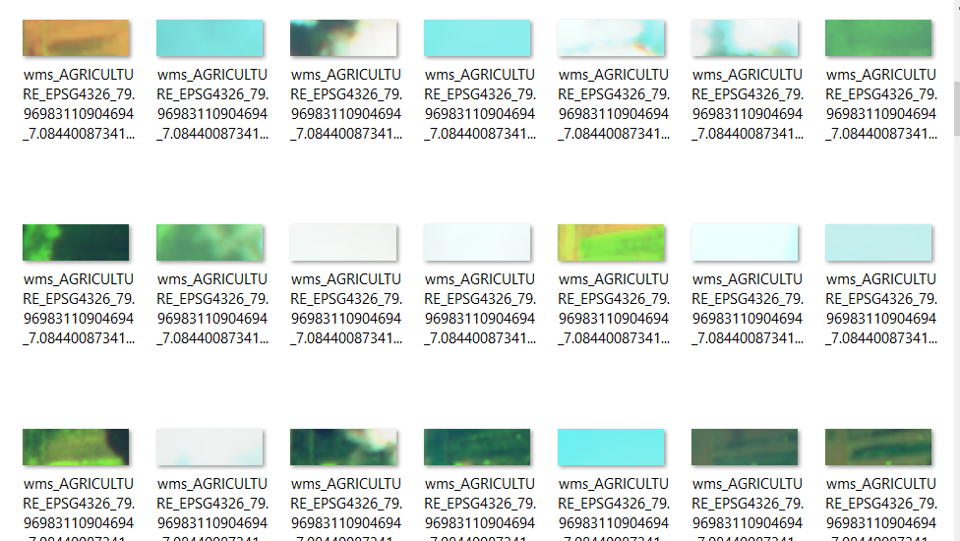
Sample of satellite images

Slide 6
Yala & Maha season works of AOI

Slide 7
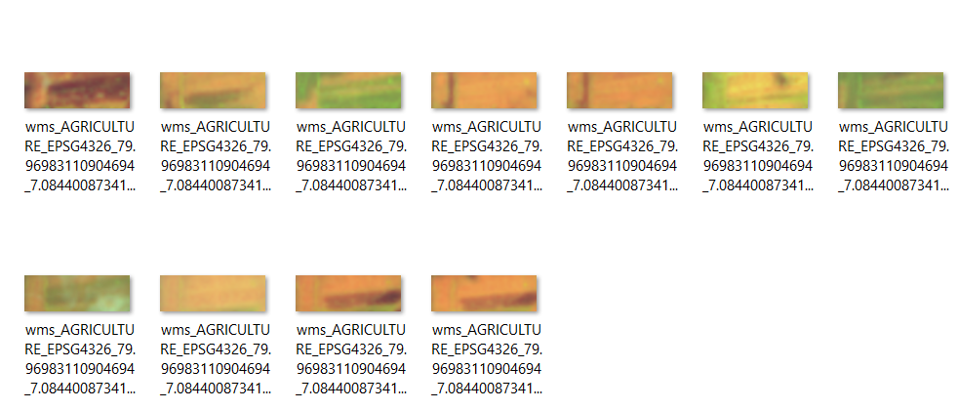
Sample of landing class

Slide 8
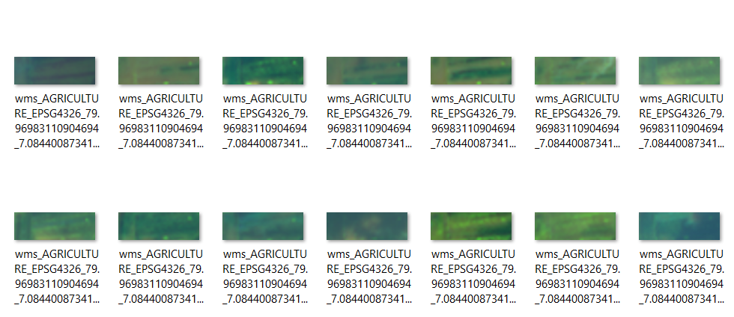
Sample of vegetative class

Slide 9
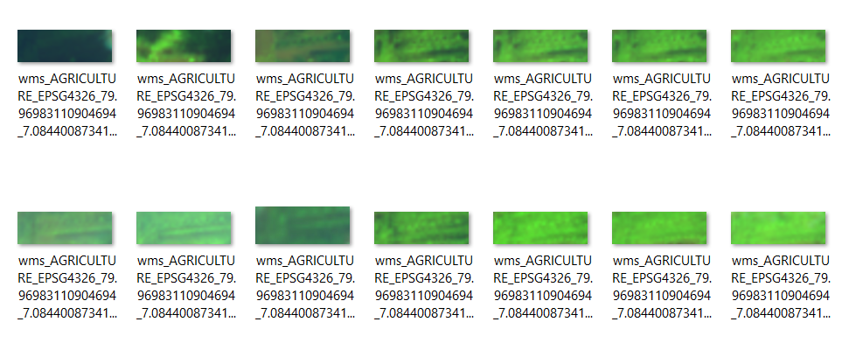
Sample of reproduction class

Slide 10
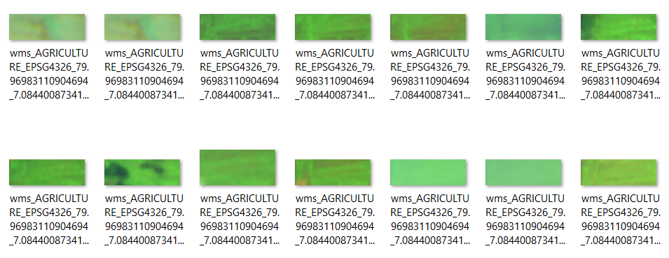
Sample of ripening class

Slide 11
Model paddy crop classification
SVM classifier for cloud detection or partial coverage detection
SVM classifier for paddy stage prediction
CNN classifier for paddy stage prediction

Slide 12
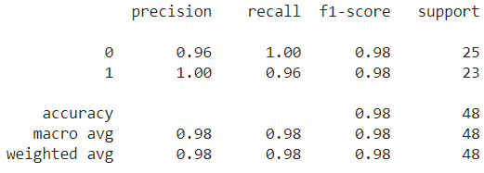
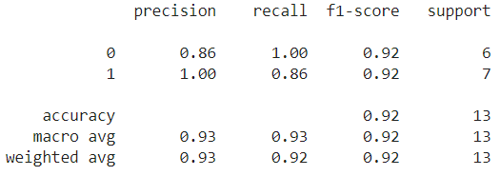
SVM classifier for cloud detection case
Accuracy of train data
Accuracy of test data
C=1
Gamma=0.0001
Kernel=rbf

Slide 13
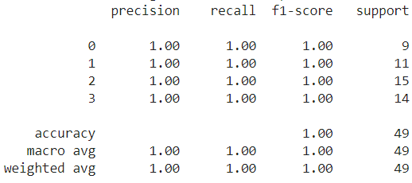
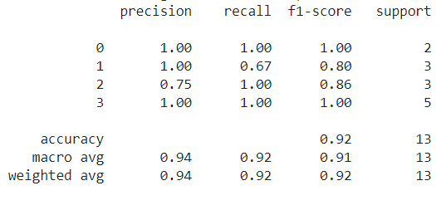
SVM for paddy stage classifier case(B11,B08,B02)
Accuracy of train data
Accuracy of test data
C=1
Gamma=0.0001
Kernel=rbf

Slide 14
CNN for paddy stage classifier case
Keras API with tensorflow back-end
real-time data augmentation (ImageDataGenerator)
Transfer Learning(for get more accurate model)
VGG-16 model as feature extractor

Slide 15
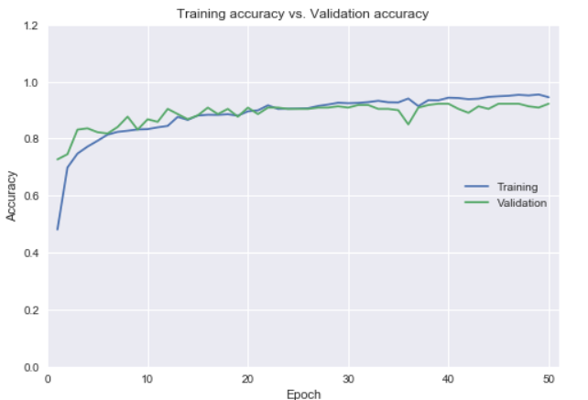
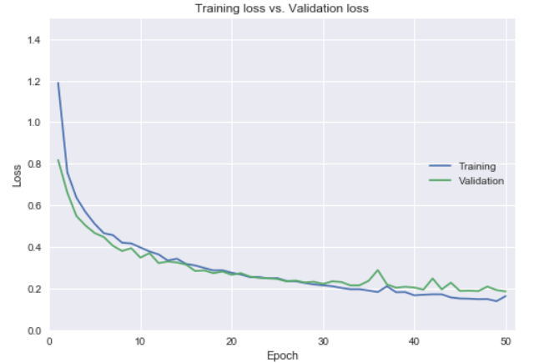
Check overfitting

Slide 16
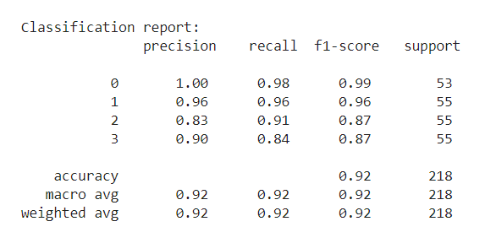
Accuracy of the CNN model

Slide 17
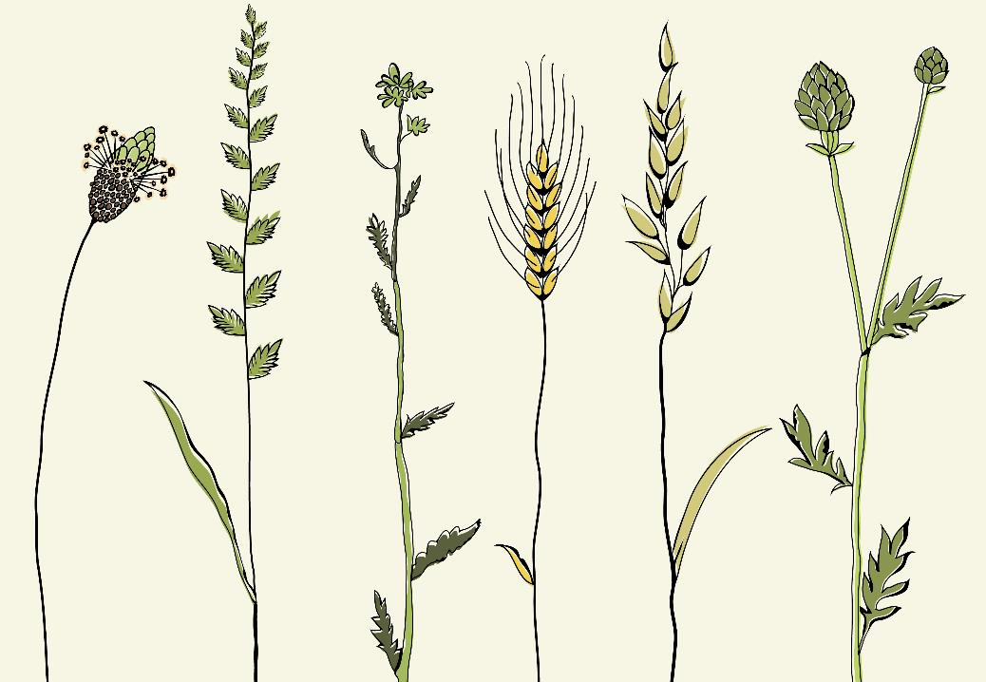
Rest works
For yield forecasting
Correlations analysis between NDVI value and past harvest data
Regression model for harvest prediction

Slide 18


Thank You
W.D Rasika
PS/2014/041

